Slide 1
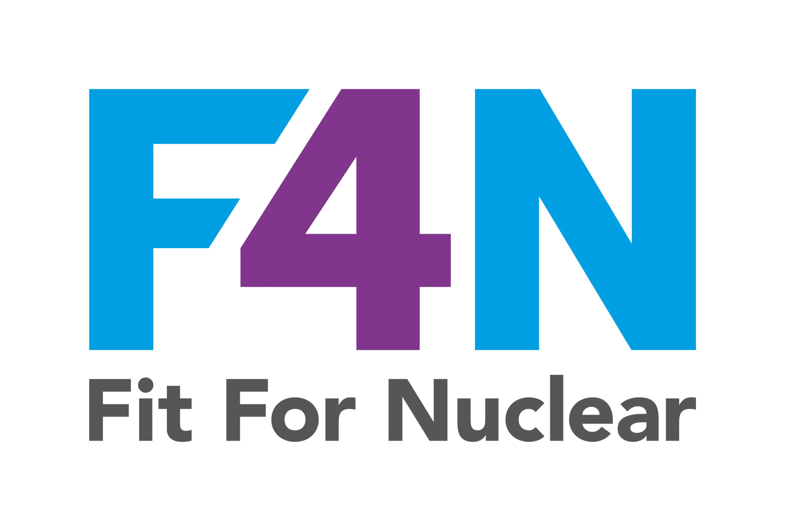

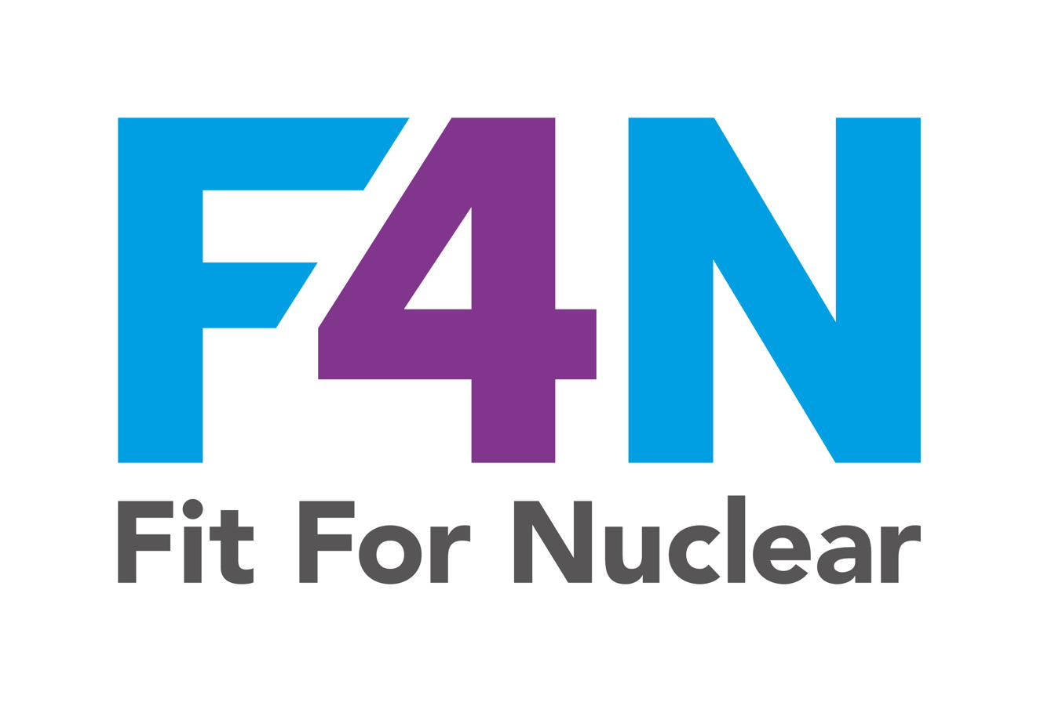
Supply Chain and Social Values
How we manage our supply chain, create social value, and meet our ethical responsibilities
Commercial in Confidence
NucCol | Nuclear Collaboration Ltd · Fit For Nuclear Programme · Commercial in Confidence | 1

Slide 2
Supply Chain and Social Values: The 10 Assessment Areas
The F4N assessment covers 10 questions across supply chain management and social values. This guide explains each area and what good looks like.
1. Supply Chain Performance Metrics
2. Supplier Relationship Management
3. Cost Analysis
4. Supply Chain Risk Management
5. Digital Transformation
Robust metrics for benchmarking and improvement
Strategic not transactional. Joint improvement plans.
TCO not just unit price. Best value assessment.
Proactive. Documented. Mitigation plans in place.
Technology in supply chain decision-making.
6. Community Engagement
7. Ethical Sourcing
8. Environmental Sustainability
9. Diversity and Inclusion
10. Labour Standards
Active contribution to local community.
Supplier Code of Conduct. Due diligence. Transparency.
Targets, reporting, and continuous improvement.
Equal opportunity. Data-driven. Culture of respect.
Fair wages, safe conditions, no forced labour, modern slavery.
NucCol | Nuclear Collaboration Ltd · Fit For Nuclear Programme · Commercial in Confidence | 2

Slide 3
Supply Chain Performance Metrics
The assessor wants to see a robust set of supply chain metrics used for benchmarking, improvement, and communication with suppliers. Not just internal data.
Quality
Delivery
Cost
Supplier
Social Value
Right First Time % (RFT)
NCR rate (internal vs supplier)
Cost of Poor Quality
Certificate non-conformance rate
On Time In Full % (OTIF)
Lead time adherence
Supplier delivery reliability
Total Cost of Ownership
Cost reduction vs target
Price stability %
Savings achieved (£)
Scorecard scores
SCAR raised and closed
Supplier development actions
Community hours volunteered
Local supply chain %
Apprentices employed
Carbon reduction %
NucCol | Nuclear Collaboration Ltd · Fit For Nuclear Programme · Commercial in Confidence | 3

Slide 4
Supplier Relationships and Risk Management
These two questions are linked. Strategic relationships reduce risk. Transactional relationships increase it.
TRANSACTIONAL
(Score 0-2)
OPERATIONAL
(Score 3-5)
TACTICAL
(Score 6-8)
STRATEGIC
(Score 9-10)
Order placed. Invoice paid. No further contact.
Risk: supplier failure is a surprise. No joint improvement. No forward visibility.
Regular contact on live orders. Performance issues discussed reactively.
Risk: relationship is reactive, not proactive. Little strategic alignment.
Regular performance reviews. Scorecard shared. Some joint improvement activity.
Good: but still primarily focused on current contracts.
Senior-to-senior relationships. Joint improvement plans. Forward pipeline shared. Risk managed collaboratively. Innovation discussed.
This is where F4N wants to see your Tier 1 suppliers.
NucCol | Nuclear Collaboration Ltd · Fit For Nuclear Programme · Commercial in Confidence | 4

Slide 5
Cost Analysis: Total Cost of Ownership
The assessor asks whether you can differentiate between unit cost, total cost, and value for money. A decision based only on unit price is not best value.
UNIT PRICE
TOTAL COST OF OWNERSHIP
BEST VALUE
The price on the invoice.
This is the starting point, not the end point.
Unit price PLUS:
- Freight and packaging
- Goods receipt / inspection
- Certificate handling
- NCR and rework cost
- Buffer stock holding
- Supplier management time
TCO PLUS qualitative factors:
- Quality system maturity
- Nuclear compliance
- Delivery reliability
- Financial stability
- Environmental / social value
Lowest price does not mean lowest cost.
TCO is the real cost of buying from a supplier.
Best value = right outcome at right total cost. Not cheapest.
NucCol | Nuclear Collaboration Ltd · Fit For Nuclear Programme · Commercial in Confidence | 5

Slide 6
Digital Transformation in the Supply Chain
The assessor assesses how digital technology is used to inform supply chain decisions. From manual spreadsheets to AI-driven automation.
LEVEL 1
(Score 0-2)
Manual/Paper
Spreadsheets and email. No integrated systems.
LEVEL 2
(Score 3-4)
Basic Digital
ERP or MRP in use but not integrated. Processes still largely manual.
LEVEL 3
(Score 5-6)
Partially Integrated
ERP linked to accounts. QMS in place. Some automation.
LEVEL 4
(Score 7-8)
Fully Integrated
ERP, QMS, supplier portal integrated. Real-time data visibility.
LEVEL 5
(Score 9-10)
Advanced
Predictive analytics. AI demand planning. Automated alerts. Digital twin.
NucCol | Nuclear Collaboration Ltd · Fit For Nuclear Programme · Commercial in Confidence | 6

Slide 7
Community Engagement and Social Responsibility
Community engagement is assessed on whether it is systematic, leadership-supported, and generating measurable social value — not ad hoc or accidental.
Education and STEM
Apprenticeships
Volunteering
School visits, college partnerships, STEM ambassador activities, nuclear career outreach
Local apprentice recruitment, T-level placements, work experience programmes
Employee volunteering days, charity fundraising, community clean-up activities
Local Procurement
Charitable Support
Industry Engagement
Preferencing local suppliers. Local employment. Keeping spend in the community.
Sponsorship, donations, fundraising for local charities and community organisations.
Nuclear supply chain events, F4N engagement, industry body participation.
NucCol | Nuclear Collaboration Ltd · Fit For Nuclear Programme · Commercial in Confidence | 7

Slide 8
Ethical Sourcing
Ethical sourcing means ensuring that the goods and services we buy are produced under fair and legal conditions, with full transparency about where they come from.
Supplier Code of Conduct
Supply Chain Due Diligence
All strategic suppliers sign our Code of Conduct covering quality, labour, environment, and anti-corruption.
Before approving a new supplier: quality system check, ethical trading, financial stability, labour standards.
Modern Slavery Prevention
CFSI Prevention
No forced, trafficked, or child labour in our supply chain. Annual supply chain risk assessment published.
Counterfeit, Fraudulent, and Suspect Items are an ethical as well as quality issue. Zero tolerance.
Transparency
Anti-Corruption
Supply chain mapping available for nuclear customers. Traceability to material source for safety-classified items.
We comply with the Bribery Act 2010. No facilitation payments. No gifts beyond policy limits.
NucCol | Nuclear Collaboration Ltd · Fit For Nuclear Programme · Commercial in Confidence | 8

Slide 9
Environmental Sustainability
Environmental sustainability is assessed on whether it is integrated into operations with measurable targets and regular reporting — not just a policy on a shelf.
Energy and Carbon
Waste
Water
Measure energy use and Scope 1/2 carbon. Set annual reduction targets. Report in management review.
Minimise waste to landfill. Segregated recycling. Metal swarf recycled. Hazardous waste via licensed contractor.
Monitor water consumption. Set reduction targets. Report annually.
Transport
Supply Chain
ISO 14001
Reduce business travel. Fleet decarbonisation plan. Encourage active travel.
Require Tier 1 suppliers to provide environmental data. ISO 14001 as qualification criterion.
Working towards or holding ISO 14001:2015 certification. Use our readiness assessment (SC-SV-08) as a roadmap.
NucCol | Nuclear Collaboration Ltd · Fit For Nuclear Programme · Commercial in Confidence | 9

Slide 10
Diversity, Inclusion, and Labour Standards
These two questions assess whether the company treats people fairly — its own employees and those in its supply chain.
Diversity and Inclusion
Labour Standards
Modern Slavery
Equality Act 2010 compliance
National Living Wage as minimum
Modern Slavery Act 2015 compliance
Inclusive recruitment practices
Working Time Regulations compliance
Annual statement published (>£36m)
Diversity data monitored annually
Safe and lawful working conditions
Supply chain risk assessment
D&I training for all managers
Freedom of association respected
Supplier Code of Conduct requirement
Gender pay gap monitored
No forced or child labour
Employee training on indicators
Zero tolerance for discrimination
Fair and transparent pay statements
Clear reporting mechanism
NucCol | Nuclear Collaboration Ltd · Fit For Nuclear Programme · Commercial in Confidence | 10

Slide 11
Your Supply Chain and Social Values Toolkit
These documents cover all 10 F4N assessment questions. Use them as live operational tools.
SC-SV-01
Approved Supplier List and Scorecard
SC-SV-02
Supply Chain Risk Register
ASL, quarterly scorecard, SCAR log. Core supply chain evidence.
Risk matrix, mitigation tracker, review schedule.
SC-SV-03
Procurement and Cost Analysis
SC-SV-04
Supplier Relationship Management Plan
TCO model, best value assessment, cost reduction tracker.
Meeting cadence, joint improvement, communication log.
SC-SV-05
Digital Transformation Register
SC-SV-06
Social Value and Ethical Sourcing Policy
Tools inventory, roadmap, maturity assessment.
All five social value commitments. Supplier Code of Conduct.
SC-SV-07
Social Value Action Plan
SC-SV-08
Environmental Sustainability Plan
Community log, metrics, D&I data, action plan.
Targets, action plan, monthly log, ISO 14001 readiness.
SC-SV-09
Diversity and Inclusion Framework
SC-SV-10
Labour Standards and Modern Slavery Statement
NucCol | Nuclear Collaboration Ltd · Fit For Nuclear Programme · Commercial in Confidence | 11

Slide 12
Supply Chain and Social Values
Three things to remember:
1. A great supply chain is strategic, not transactional. 2. Best value is not the same as lowest price. 3. Social value is measured, not assumed.
Questions? Speak to the Procurement or Operations Manager.
Commercial in Confidence | [Company Name] | [Date]
NucCol | Nuclear Collaboration Ltd · Fit For Nuclear Programme · Commercial in Confidence | 12

